Slide 1
CS162
Operating Systems and
Systems Programming
Lecture 16
Page Allocation and
Replacement (con’t)
I/O Systems
October 27, 2010
Prof. John Kubiatowicz
http://inst.eecs.berkeley.edu/~cs162

Slide 2
Review: Page Replacement Policies
FIFO (First In, First Out)
  Throw out oldest page. Be fair – let every page live in memory for same amount of time.
  Bad, because throws out heavily used pages instead of infrequently used pages
MIN (Minimum):
  Replace page that won’t be used for the longest time
  Great, but can’t really know future…
  Makes good comparison case, however
RANDOM:
  Pick random page for every replacement
  Typical solution for TLB’s. Simple hardware
  Pretty unpredictable – makes it hard to make real-time guarantees
LRU (Least Recently Used):
  Replace page that hasn’t been used for the longest time
  Programs have locality, so if something not used for a while, unlikely to be used in the near future.
  Seems like LRU should be a good approximation to MIN.

Slide 3

Review: Clock Algorithm: Not Recently Used
Set of all pages
in Memory
Single Clock Hand:
  Advances only on page fault!
  Check for pages not used recently
  Mark pages as not used recently
Clock Algorithm: pages arranged in a ring
  Hardware “use” bit per physical page:
    Hardware sets use bit on each reference
    If use bit isn’t set, means not referenced in a long time
    Nachos hardware sets use bit in the TLB; you have to copy this back to page table when TLB entry gets replaced
  On page fault:
    Advance clock hand (not real time)
    Check use bit: 1→used recently; clear and leave alone
    0→selected candidate for replacement

Slide 4
Review: N^{th} Chance version of Clock Algorithm
N^{th} chance algorithm: Give page N chances
  OS keeps counter per page: # sweeps
  On page fault, OS checks use bit:
    1⇒clear use and also clear counter (used in last sweep)
    0⇒increment counter; if count=N, replace page
  Means that clock hand has to sweep by N times without page being used before page is replaced
How do we pick N?
  Why pick large N? Better approx to LRU
    If N ~ 1K, really good approximation
  Why pick small N? More efficient
    Otherwise might have to look a long way to find free page
What about dirty pages?
  Takes extra overhead to replace a dirty page, so give dirty pages an extra chance before replacing?
  Common approach:
    Clean pages, use N=1
    Dirty pages, use N=2 (and write back to disk when N=1)

Slide 5
Goals for Today
Finish Page Allocation Policies
Working Set/Thrashing
I/O Systems
  Hardware Access
  Device Drivers
Note: Some slides and/or pictures in the following are
adapted from slides ©2005 Silberschatz, Galvin, and Gagne
Note: Some slides and/or pictures in the following are
adapted from slides ©2005 Silberschatz, Galvin, and Gagne. Many slides generated from my lecture notes by Kubiatowicz.

Slide 6
Second-Chance List Algorithm (VAX/VMS)
LRU victim
Directly
Mapped Pages
Marked: RW
List: FIFO
Overflow
Second
Chance List
Marked: Invalid
List: LRU
Access
New
Active
Pages
New
SC
Victims
Page-in
From disk
Split memory in two: Active list (RW), SC list (Invalid)
Access pages in Active list at full speed
Otherwise, Page Fault
  Always move overflow page from end of Active list to front of Second-chance list (SC) and mark invalid
  Desired Page On SC List: move to front of Active list, mark RW
  Not on SC list: page in to front of Active list, mark RW; page out LRU victim at end of SC list

Slide 7
Second-Chance List Algorithm (con’t)
How many pages for second chance list?
  If 0 ⇒ FIFO
  If all ⇒ LRU, but page fault on every page reference
Pick intermediate value. Result is:
  Pro: Few disk accesses (page only goes to disk if unused for a long time)
  Con: Increased overhead trapping to OS (software / hardware tradeoff)
With page translation, we can adapt to any kind of access the program makes
  Later, we will show how to use page translation / protection to share memory between threads on widely separated machines
Question: why didn’t VAX include “use” bit?
  Strecker (architect) asked OS people, they said they didn’t need it, so didn’t implement it
  He later got blamed, but VAX did OK anyway

Slide 8
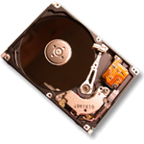
Free List
Set of all pages
in Memory
Single Clock Hand:
  Advances as needed to keep freelist full (“background”)
D
D
Free Pages
For Processes
Keep set of free pages ready for use in demand paging
  Freelist filled in background by Clock algorithm or other technique (“Pageout demon”)
  Dirty pages start copying back to disk when enter list
Like VAX second-chance list
  If page needed before reused, just return to active set
Advantage: Faster for page fault
  Can always use page (or pages) immediately on fault

Slide 9
Demand Paging (more details)
Does software-loaded TLB need use bit?
Two Options:
  Hardware sets use bit in TLB; when TLB entry is replaced, software copies use bit back to page table
  Software manages TLB entries as FIFO list; everything not in TLB is Second-Chance list, managed as strict LRU
Core Map
  Page tables map virtual page → physical page
  Do we need a reverse mapping (i.e. physical page → virtual page)?
    Yes. Clock algorithm runs through page frames. If sharing, then multiple virtual-pages per physical page
    Can’t push page out to disk without invalidating all PTEs

Slide 10
Administrivia
Still Grading Midterms
  Hope to hand them out tomorrow – almost done
  Solutions have been posted
    Just go to handouts page
Would you like an extra 5% for your course grade?
  Attend lectures and sections! 5% of grade is participation
  Midterm 1 was only 20%
We have an anonymous feedback link on the course homepage
  Please use to give feedback on course
  Soon: We will have a survey to fill out
Should be working on Project 3 now.
  Autograder is intentionally running intermittently!
  You must rely on your tests, not the autograder

Slide 11
Review from Test: Monitors
Monitors represent the logic of the program
  Wait if necessary
  Signal when change something so any waiting threads can proceed
  Remarkably – some didn’t start with basic structure!
Basic structure of monitor-based program:
  lock
  while (need to wait) {
  condvar.wait();
  }
  unlock
  do something so no need to wait
  lock
  condvar.signal();
  unlock
Check and/or update
state variables
Wait if necessary
Check and/or update
state variables

Slide 12
Review From Test: Continued
Can you get a deadlock with a single monitor?
  Yes – use two condition variables!
Simplest way to see: Implement semaphores:
  X.p(): mylock.acquire(); X.v(): mylock.acquire();
  while (Xvalue == 0) Xvalue++;
  Xcond.wait(); Xcond.signal();
  Xvalue--; mylock.release();
  mylock.release();
  Same for Y (using Yvalue and Ycond)
  Then, write:
  X.p() Y.p()
  Y.p() X.p()
Remember: Monitors ⇔ Semaphores from standpoint of functionality!

Slide 13
Allocation of Page Frames (Memory Pages)
How do we allocate memory among different processes?
  Does every process get the same fraction of memory? Different fractions?
  Should we completely swap some processes out of memory?
Each process needs minimum number of pages
  Want to make sure that all processes that are loaded into memory can make forward progress
  Example: IBM 370 – 6 pages to handle SS MOVE instruction:
    instruction is 6 bytes, might span 2 pages
    2 pages to handle from
    2 pages to handle to
Possible Replacement Scopes:
  Global replacement – process selects replacement frame from set of all frames; one process can take a frame from another
  Local replacement – each process selects from only its own set of allocated frames

Slide 14
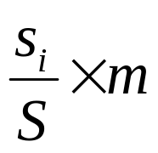
Fixed/Priority Allocation
Equal allocation (Fixed Scheme):
  Every process gets same amount of memory
  Example: 100 frames, 5 processes⇒process gets 20 frames
Proportional allocation (Fixed Scheme)
  Allocate according to the size of process
  Computation proceeds as follows:
  s_{i} = size of process p_{i} and S = Σs_{i}
  m = total number of frames
  a_{i} = allocation for p_{i} =
Priority Allocation:
  Proportional scheme using priorities rather than size
    Same type of computation as previous scheme
  Possible behavior: If process p_{i} generates a page fault, select for replacement a frame from a process with lower priority number
Perhaps we should use an adaptive scheme instead???
  What if some application just needs more memory?

Slide 15

Page-Fault Frequency Allocation
Can we reduce Capacity misses by dynamically changing the number of pages/application?
Establish “acceptable” page-fault rate
  If actual rate too low, process loses frame
  If actual rate too high, process gains frame
Question: What if we just don’t have enough memory?

Slide 16

Thrashing
If a process does not have “enough” pages, the page-fault rate is very high. This leads to:
  low CPU utilization
  operating system spends most of its time swapping to disk
Thrashing ≡ a process is busy swapping pages in and out
Questions:
  How do we detect Thrashing?
  What is best response to Thrashing?
Notes:
Example: one program, touches 50 pages (each equally likely). Have only 40 physical page frames.
How bad is this?
- Does your program run at 80% speed?
- Does your program run at 20% speed?
Performance is really bad
If we have enough pages, 200 ns/ref, but if too few pages, assume every 5th page reference causes a page fault
= 4 refs x 200 ns
1 page fault x 10 ms for disk I/O
= 5 refs, 10 ms + 800 ns => 2 ms/ref (not 100 MIPS, but 500 IPS! Factor of 10,000)
Machine appears to have stopped!

Slide 17
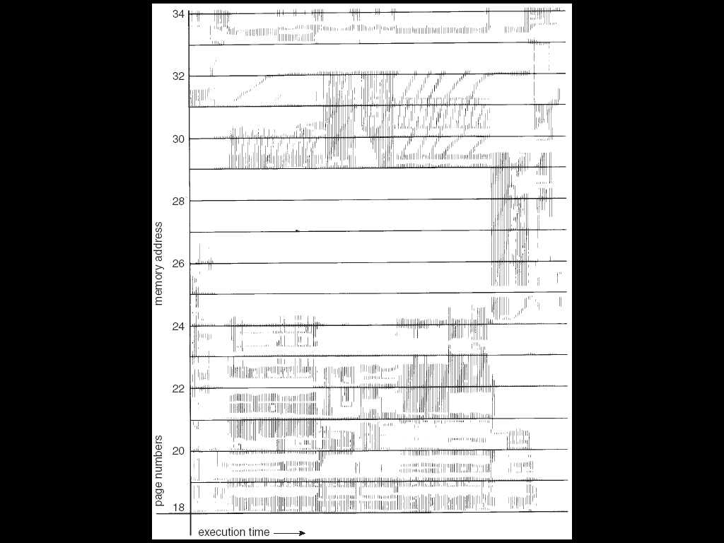
Locality In A Memory-Reference Pattern
Program Memory Access Patterns have temporal and spatial locality
  Group of Pages accessed along a given time slice called the “Working Set”
  Working Set defines minimum number of pages needed for process to behave well
Not enough memory for Working Set⇒Thrashing
  Better to swap out process?

Slide 18

Working-Set Model
Δ ≡ working-set window ≡ fixed number of page references
  Example: 10,000 instructions
WS_{i} (working set of Process P_{i}) = total set of pages referenced in the most recent Δ (varies in time)
  if Δ too small will not encompass entire locality
  if Δ too large will encompass several localities
  if Δ = ∞ ⇒ will encompass entire program
D = Σ|WS_{i}| ≡ total demand frames
if D > m ⇒ Thrashing
  Policy: if D > m, then suspend/swap out processes
  This can improve overall system behavior by a lot!

Slide 19
What about Compulsory Misses?
Recall that compulsory misses are misses that occur the first time that a page is seen
  Pages that are touched for the first time
  Pages that are touched after process is swapped out/swapped back in
Clustering:
  On a page-fault, bring in multiple pages “around” the faulting page
  Since efficiency of disk reads increases with sequential reads, makes sense to read several sequential pages
Working Set Tracking:
  Use algorithm to try to track working set of application
  When swapping process back in, swap in working set

Slide 20
Demand Paging Summary
Replacement policies
  FIFO: Place pages on queue, replace page at end
  MIN: Replace page that will be used farthest in future
  LRU: Replace page used farthest in past
Clock Algorithm: Approximation to LRU
  Arrange all pages in circular list
  Sweep through them, marking as not “in use”
  If page not “in use” for one pass, than can replace
N^{th}-chance clock algorithm: Another approx LRU
  Give pages multiple passes of clock hand before replacing
Second-Chance List algorithm: Yet another approx LRU
  Divide pages into two groups, one of which is truly LRU and managed on page faults.
Working Set:
  Set of pages touched by a process recently
Thrashing: a process is busy swapping pages in and out
  Process will thrash if working set doesn’t fit in memory
  Need to swap out a process

Slide 21
The Requirements of I/O
So far in this course:
  We have learned how to manage CPU, memory
What about I/O?
  Without I/O, computers are useless (disembodied brains?)
  But… thousands of devices, each slightly different
    How can we standardize the interfaces to these devices?
  Devices unreliable: media failures and transmission errors
    How can we make them reliable???
  Devices unpredictable and/or slow
    How can we manage them if we don’t know what they will do or how they will perform?
Some operational parameters:
  Byte/Block
    Some devices provide single byte at a time (e.g. keyboard)
    Others provide whole blocks (e.g. disks, networks, etc)
  Sequential/Random
    Some devices must be accessed sequentially (e.g. tape)
    Others can be accessed randomly (e.g. disk, cd, etc.)
  Polling/Interrupts
    Some devices require continual monitoring
    Others generate interrupts when they need service

Slide 22


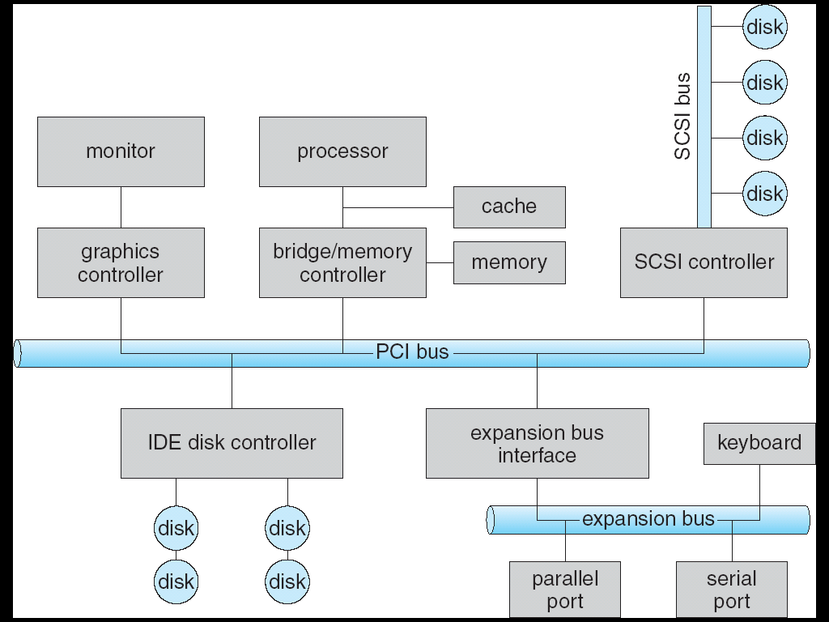




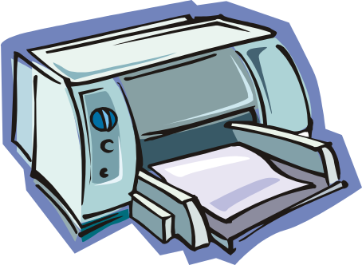


Modern I/O Systems

Slide 23
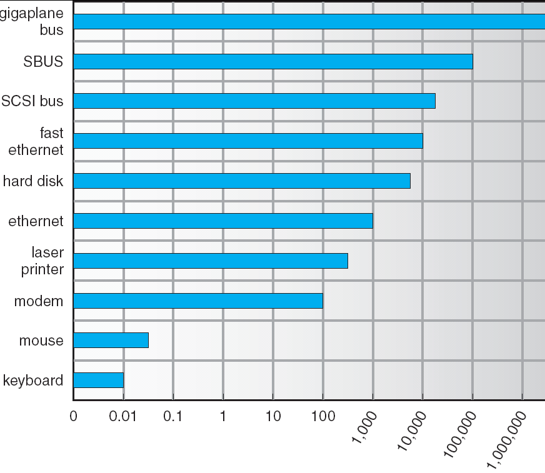
Example Device-Transfer Rates (Sun Enterprise 6000)
Device Rates vary over many orders of magnitude
  System better be able to handle this wide range
  Better not have high overhead/byte for fast devices!
  Better not waste time waiting for slow devices

Slide 24
The Goal of the I/O Subsystem
Provide Uniform Interfaces, Despite Wide Range of Different Devices
  This code works on many different devices:
  FILE fd = fopen(“/dev/something”,”rw”);
  for (int i = 0; i < 10; i++) {
  fprintf(fd,”Count %d\n”,i);
  }
  close(fd);
  Why? Because code that controls devices (“device driver”) implements standard interface.
We will try to get a flavor for what is involved in actually controlling devices in rest of lecture
  Can only scratch surface!

Slide 25
Want Standard Interfaces to Devices
Block Devices: e.g. disk drives, tape drives, DVD-ROM
  Access blocks of data
  Commands include open(), read(), write(), seek()
  Raw I/O or file-system access
  Memory-mapped file access possible
Character Devices: e.g. keyboards, mice, serial ports, some USB devices
  Single characters at a time
  Commands include get(), put()
  Libraries layered on top allow line editing
Network Devices: e.g. Ethernet, Wireless, Bluetooth
  Different enough from block/character to have own interface
  Unix and Windows include socket interface
    Separates network protocol from network operation
    Includes select() functionality
  Usage: pipes, FIFOs, streams, queues, mailboxes

Slide 26
How Does User Deal with Timing?
Blocking Interface: “Wait”
  When request data (e.g. read() system call), put process to sleep until data is ready
  When write data (e.g. write() system call), put process to sleep until device is ready for data
Non-blocking Interface: “Don’t Wait”
  Returns quickly from read or write request with count of bytes successfully transferred
  Read may return nothing, write may write nothing
Asynchronous Interface: “Tell Me Later”
  When request data, take pointer to user’s buffer, return immediately; later kernel fills buffer and notifies user
  When send data, take pointer to user’s buffer, return immediately; later kernel takes data and notifies user

Slide 27
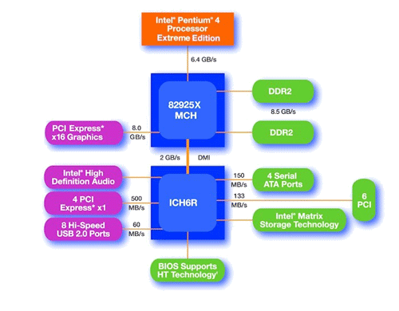
Main components of Intel Chipset: Pentium 4
Northbridge:
  Handles memory
  Graphics
Southbridge: I/O
  PCI bus
  Disk controllers
  USB controllers
  Audio
  Serial I/O
  Interrupt controller
  Timers

Slide 28
How does the processor actually talk to the device?
Processor Memory Bus
Regular
Memory
CPU
Bus
Adaptor
Bus
Adaptor
Device
Controller
Address+
Data
Other Devices
or Buses
Bus
Interface
Hardware
Controller
Interrupt
Controller
Interrupt Request
read
Addressable
Memory
and/or
Queues
write
CPU interacts with a Controller
  Contains a set of registers that
  can be read and written
  May contain memory for request
  queues or bit-mapped images
Regardless of the complexity of the connections and buses, processor accesses registers in two ways:
  I/O instructions: in/out instructions
    Example from the Intel architecture: out 0x21,AL
  Memory mapped I/O: load/store instructions
    Registers/memory appear in physical address space
    I/O accomplished with load and store instructions
control
status
Registers
(port 0x20)
Memory Mapped
Region: 0x8f008020

Slide 29
Example: Memory-Mapped Display Controller
Memory-Mapped:
  Hardware maps control registers and display memory into physical address space
    Addresses set by hardware jumpers or programming at boot time
  Simply writing to display memory (also called the “frame buffer”) changes image on screen
    Addr: 0x8000F000—0x8000FFFF
  Writing graphics description to command-queue area
    Say enter a set of triangles that describe some scene
    Addr: 0x80010000—0x8001FFFF
  Writing to the command register may cause on-board graphics hardware to do something
    Say render the above scene
    Addr: 0x0007F004
Can protect with page tables
0x80020000
Graphics
Command
Queue
0x80010000
Display
Memory
0x8000F000
0x0007F004
Command
0x0007F000
Status
Physical Address
Space

Slide 30

Transfering Data To/From Controller
Programmed I/O:
  Each byte transferred via processor in/out or load/store
  Pro: Simple hardware, easy to program
  Con: Consumes processor cycles proportional to data size
Direct Memory Access:
  Give controller access to memory bus
  Ask it to transfer data to/from memory directly
Sample interaction with DMA controller (from book):

Slide 31
Summary
Second-Chance List algorithm: Yet another approx LRU
  Divide pages into two groups, one of which is truly LRU and managed on page faults.
Working Set:
  Set of pages touched by a process recently
Thrashing: a process is busy swapping pages in and out
  Process will thrash if working set doesn’t fit in memory
  Need to swap out a process
I/O Devices Types:
  Many different speeds (0.1 bytes/sec to GBytes/sec)
  Different Access Patterns:
    Block Devices, Character Devices, Network Devices
  Different Access Timing:
    Blocking, Non-blocking, Asynchronous
I/O Controllers: Hardware that controls actual device
  Processor Accesses through I/O instructions, load/store to special physical memory
  Report their results through either interrupts or a status register that processor looks at occasionally (polling)

